Slide 1


INJOY An Event Management System
Cloud Academy Capstone Presentation
By Navansh Aggarwal, Sivavithyaa Shree, Vinay Majji
Notes:
JAck

Slide 2
TEAM 4
Navansh Aggarwal
Sivavithyaa Shree Mogankumar
Vinay Majji
Authorization
Step Function(Register participant)
SQS
SNS
Cognito
Logic and testing
Step Function(Create Event)
S3 Web page
RDS
API Gateway
Cognito
DynamoDB
S3
Upload and retrieve Lambdas
Secrets Manager
DynamoDB
API Gateway

Slide 3
Agenda
1. | Problem Statement | 04
2. | Understanding | 04
3 | Our Approach | 05
4. | AWS Services Implementation | 06
5. | Technical Implementation | 07
6. | Application Screenshots | 08
7. | Technical Demo | 10
8. 9. | Reflections and future enhancements References | 12 13
Notes:
Jack

Slide 4
Project Overview
Event Management System
Problem Statement
Injoy Private Ltd is an Event Management company that provides a platform where:
Admins can create events.
Participants can register for events created and listed on the site.
It also allows the users to share photos and list 10 latest photos in portfolio.
Understanding
As of our understanding, We drafted and implemented an architecture using AWS Services, So that the Company can maintain and handle the Event Management Website.

Slide 5
Our Approach
DOCUMENTATION & DESIGN
DEVELOPMENT
INTEGRATION
TESTING
Documenting application requirements and designing its architecture.
Developing microservices according to the architecture and unit test them
Assemble all AWS services and integrate them with API
Integration testing and maintenance.

Slide 6












AWS Services Implementation
RDS
COGNITO
API GATEWAY
STEP FUNCTIONS
DYNAMODB
S3
CLOUDFORMATION​
SECRETS
MANAGER​
SQS
SNS
X-RAY
LAMBDA

Slide 7
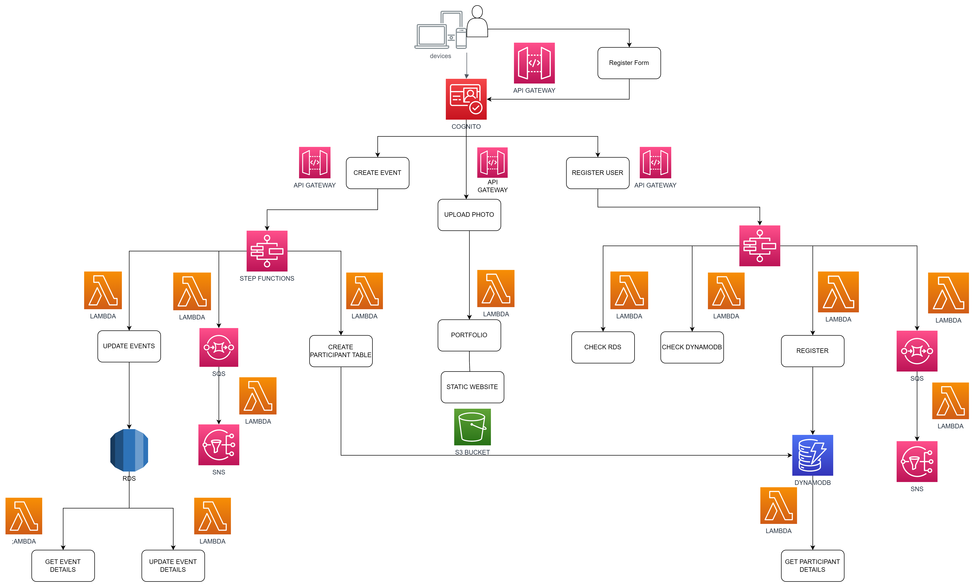
Technical Implementation

Slide 8
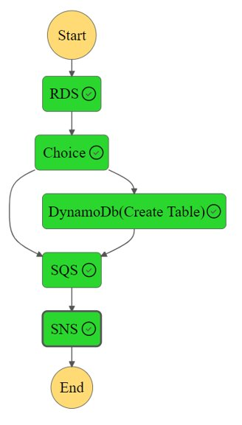
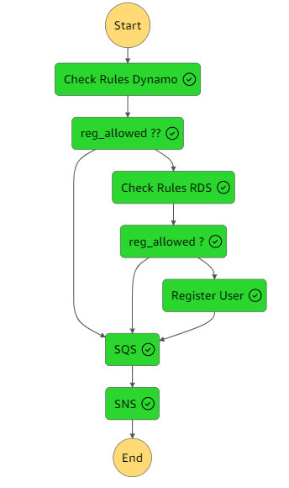
Application Screenshots
Create Event Step Function
Register User Step Function

Slide 9
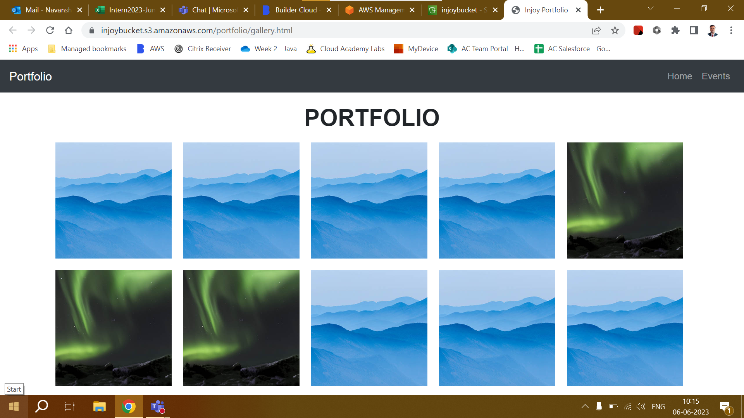
INJOY PORTFOLIO

Slide 10

Technical Demo
Injoy Event Management System

Slide 11
API Links
Create Event:
https://h9gush0kef.execute-api.us-east-1.amazonaws.com/test/postdata
Get Event details:
https://rnqkust8vb.execute-api.us-east-1.amazonaws.com/v1/events
Get Participant Details:
https://rnqkust8vb.execute-api.us-east-1.amazonaws.com/v1/participants
Update Events:
https://rnqkust8vb.execute-api.us-east-1.amazonaws.com/v1/update_rds
Register for Event:
https://yp1edty05l.execute-api.us-east-1.amazonaws.com/test/postdata
Upload Photos:
https://o3b7n4u0j0.execute-api.us-east-1.amazonaws.com/test/upload

Slide 12
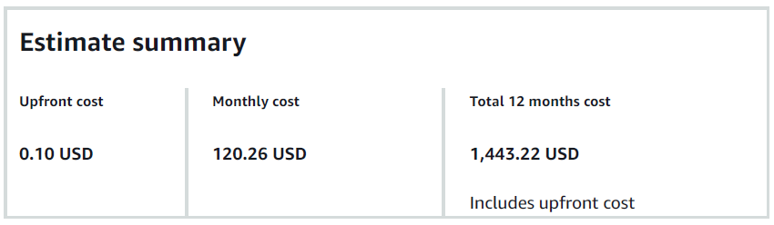
Reflections & Future Extensions
To create a front-end web application for Injoy event management system with all the necessary functionalities.
To add payment gateway for participants to securely pay for events.
To integrate discounts, coupons and other features.
To create a profile for each participant to view and manage the events that they have registered.

Slide 13
References
https://docs.aws.amazon.com/lambda/latest/dg/with-s3.html​
https://docs.aws.amazon.com/cognito/latest/developerguide/tutorial-create-user-pool.html​
https://docs.aws.amazon.com/step-functions/latest/dg/welcome.html​
https://docs.aws.amazon.com/AmazonRDS/latest/UserGuide/CHAP_GettingStarted.html​
https://docs.aws.amazon.com/AWSSimpleQueueService/latest/SQSDeveloperGuide/welcome.html​
https://docs.aws.amazon.com/sns/latest/dg/welcome.html​

Slide 14
“It's not the answer that enlightens but the question.”
Thank you!!!
pwc.com
© 2022 PwC. All rights reserved. Not for further distribution without the permission of PwC. “PwC” refers to the network of member firms of PricewaterhouseCoopers International Limited (PwCIL), or, as the context requires, individual member firms of the PwC network. Each member firm is a separate legal entity and does not act as agent of PwCIL or any other member firm. PwCIL does not provide any services to clients. PwCIL is not responsible or liable for the acts or omissions of any of its member firms nor can it control the exercise of their professional judgment or bind them in any way. No member firm is responsible or liable for the acts or omissions of any other member firm nor can it control the exercise of another member firm’s professional judgment or bind another member firm or PwCIL in any way.

